Slide 1

Becoming a
Sun Safe School
Presented by:
School name:

Slide 2

Did you know?
Australia has the highest rate of skin cancer in the world. ^{[1]}
Skin cancer is the most common cancer among young Australians (15-24-year-olds). ^{[2]}
Almost all skin cancers are caused by exposure to ultraviolet (UV) radiation. ^{[3]}
UV exposure during the first 18 years of life is the most critical risk factor for developing skin cancer. ^{[4]}
References:
1. Bray F, Ferlay J, Soerjomataram I, Siegel RL, Torre LA, Jemal A. CA Cancer J Clin 2018;68(6):394–424.
2. Australian Institute of Health and Welfare, 2023.
3. Cancer Council NSW, 2021.
4. Kimlin M, Guo Y. Sci total environ 2012;425:35-41.
Notes:
Australia has the highest rate of skin cancer in the world. Two out of three Australians will be diagnosed with skin cancer in their life. Skin cancer is highly common among young Australians as younger skin is more susceptible to UV damage due to a thinner skin layer. Sun exposure during childhood and adolescence is a critical risk factor for skin cancers in later life.

Slide 3
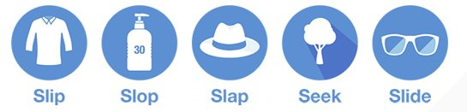
How can we reduce the risk of UV damage?
Skin cancers are highly preventable if we protect our skin from UV using the 5 forms of sun protection.
We spend a lot of time at school during peak UV periods, so we need:
- Sun safe environment (shade and clothing)
- Sun safe behaviours (hats and sunscreen)
- Sun safe communication and lessons in the classroom (PDHPE, science)
Notes:
Those stats sound scary but the good news is that skin cancer is highly preventable! We can reduce our lifetime risk by reducing exposure to UV rays and protecting our skin. As we spend most of our time in school during times of peak ultraviolet (UV) radiation, schools have the opportunity to address this issue through sun protection behaviours, education, and role modelling. World Health Organisation recommends schools to implement a program on sun protection to help students, teachers, and the wider community avoid health risks of UV exposure. This can be done by providing shade, implementing sun safe behaviours such as hats and sunscreen, or integrating these messages in the curriculum. We must take sun protection seriously!

Slide 4

"One thing" we can do
One thing we can do at our school to promote sun safety and protect us from skin cancer is [insert information about the specific project you have picked].
One initiative can make a big difference!
Notes:
PICK your "one thing" from the slides below. You can delete the slides not relevant to you.

Slide 5
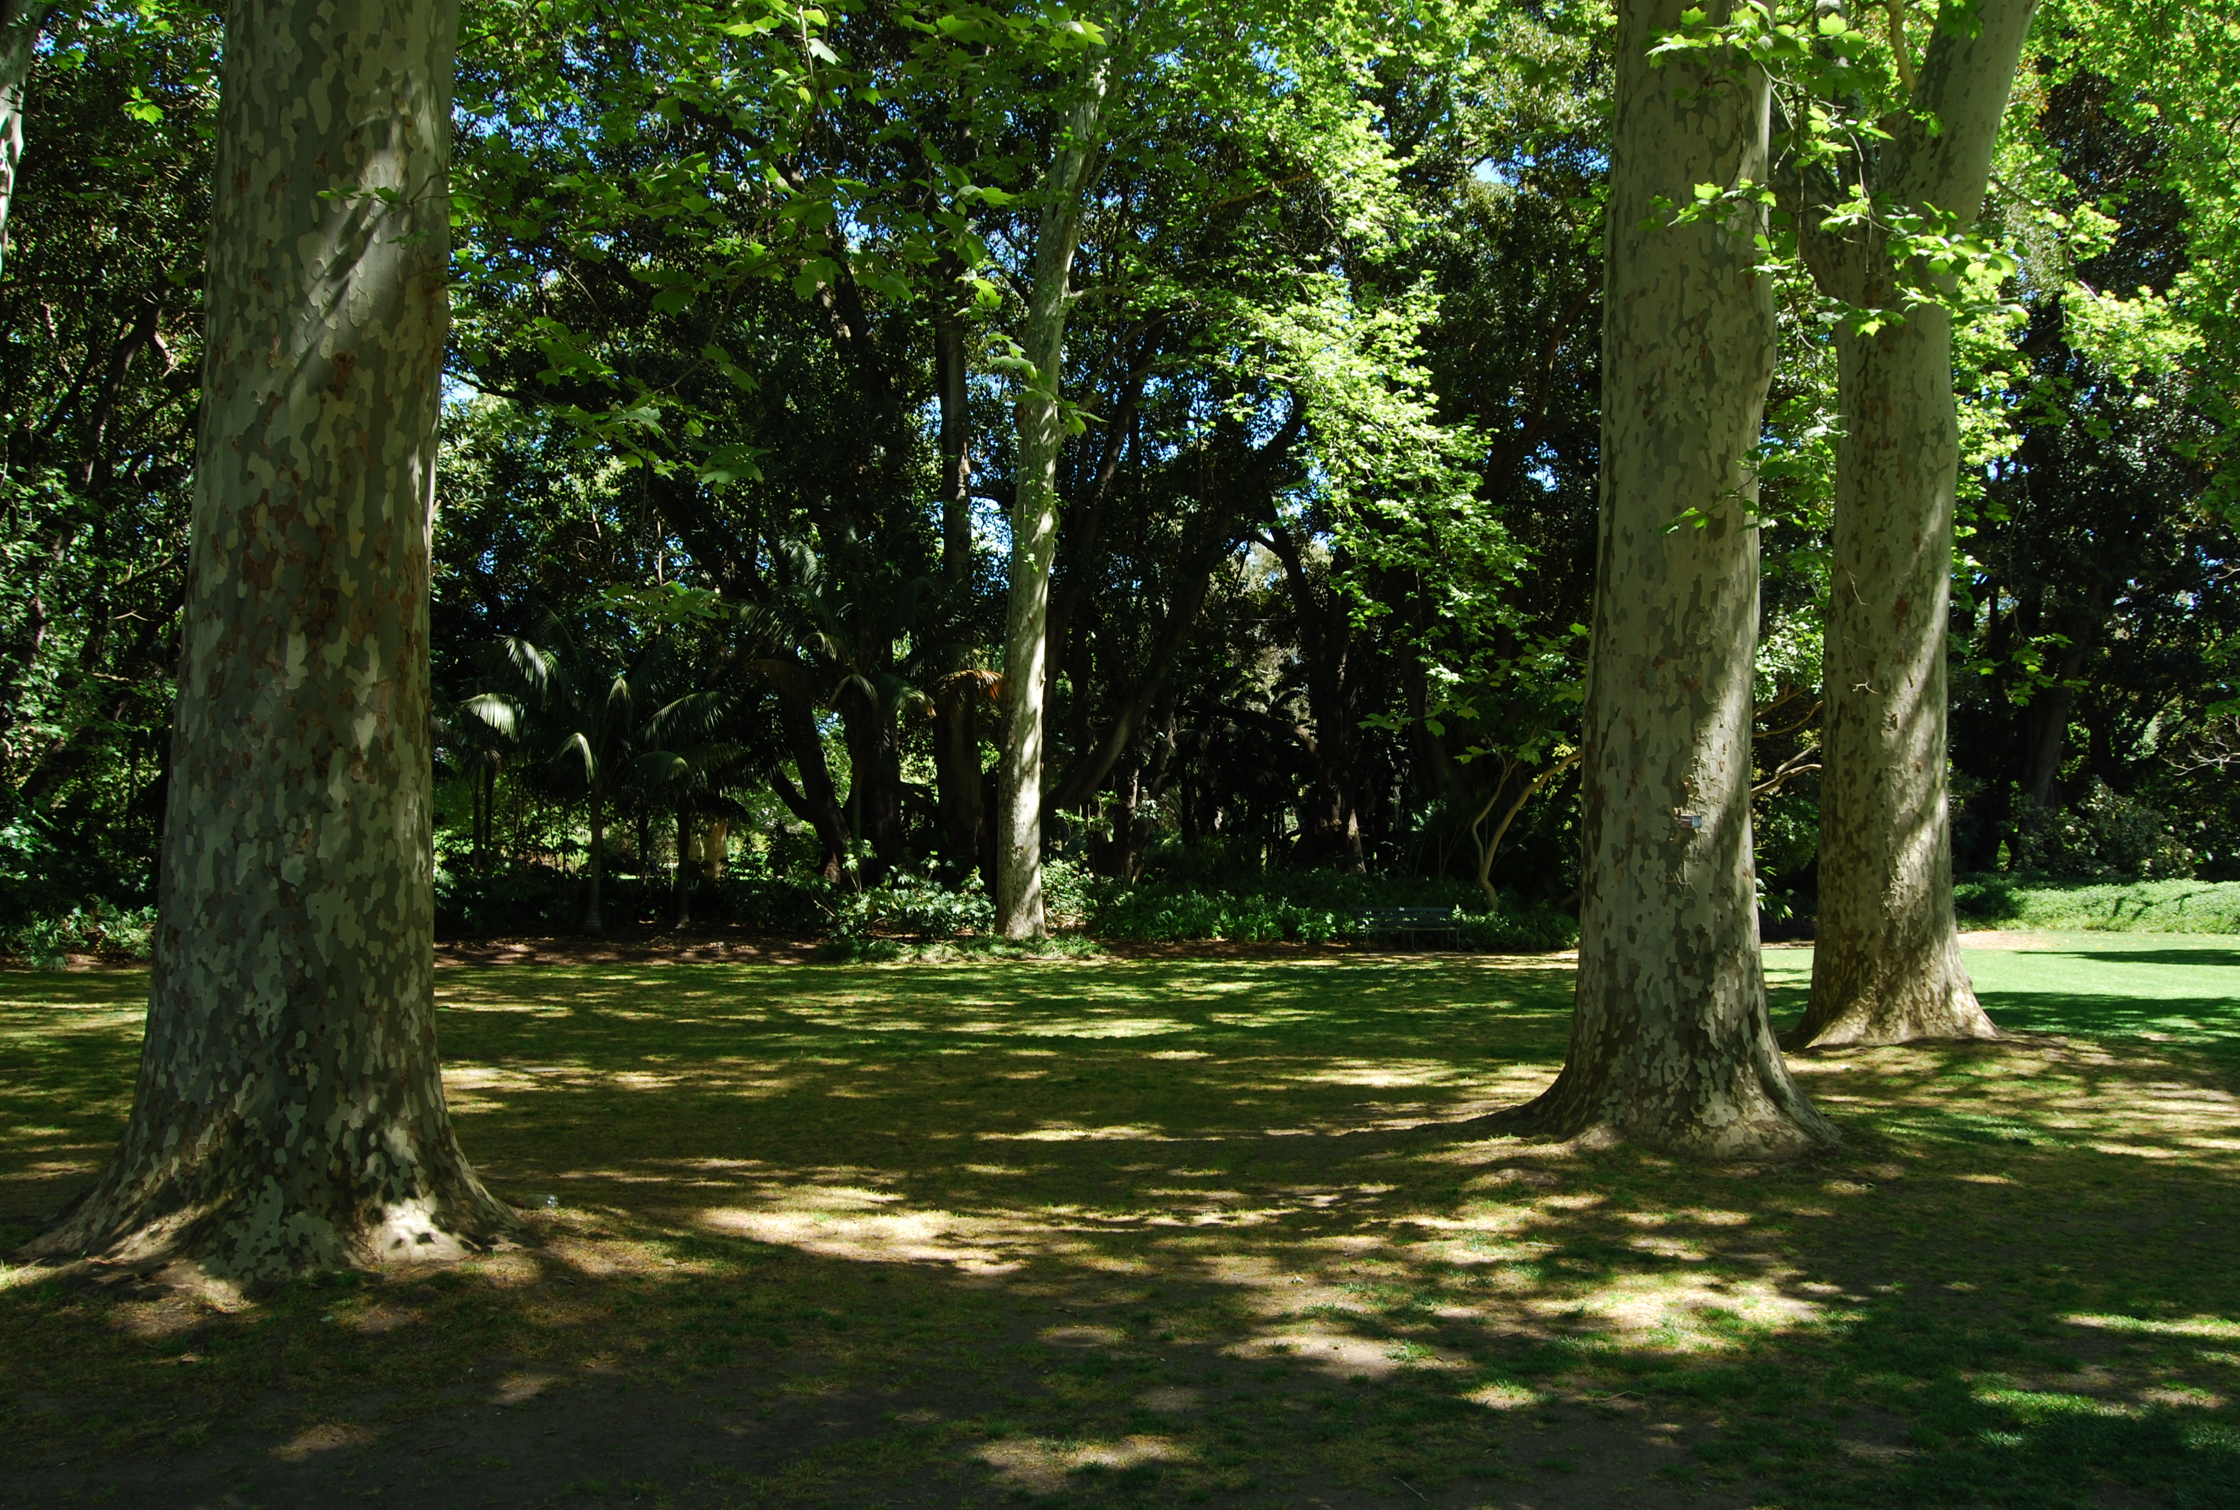
Seek Shade
Shade is one of the best ways to prevent skin cancer when used with other forms of sun protection.
In schools, built shade can also help reduce exposure to UV radiation.
Shade is not reliant on individual behaviour.
Shade helps promote outdoor
activities and health and well-being of communities.
Notes:
Shade is one of the best ways to reduce UV exposure. Shades can be natural (for example: trees), built (for example: a COLA or shade sails) or portable (for example: marquees). All forms of shade are good to help reduce our exposure to UV radiation. Considering we can get sunburnt in as little as 10 minutes, seeking shade is very important, especially during outdoor activities. When shade is provided, students tend to use it without thinking about it. In addition to its skin cancer prevention benefits, shade also helps with heat mitigation, beautifies the school, promotes outdoor activities, and improves the overall health of our communities.

Slide 6
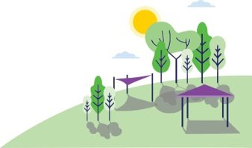
Seek Shade
Cancer Council NSW recommends shade (built and natural) to cover at least 70% of play equipment and nearby seating, to reduce overexposure to UV radiation.
Our proposal for shade is [insert information about the specific shade project or area such as where the playground/facility is and who uses it].
Notes:
We spend a lot of time at school, especially during peak UV hours. Therefore, shade is one of the best things we can do to protect our community from the harmful effects of UV and the risk of skin cancers. First of all, we have audited the available shade in our school and found that [insert your audit finding here. For example: more shade required for canteen area]. Now we seek to increase shade (natural or built) in the school grounds, especially in areas where students gather at peak UV radiation periods. After enough shade is available, we will need to promote ways to seek shade among students. For funding, [insert your plan here, for example: inviting the P&C to fund the shade project, running a fundraising activity etc.]

Slide 7
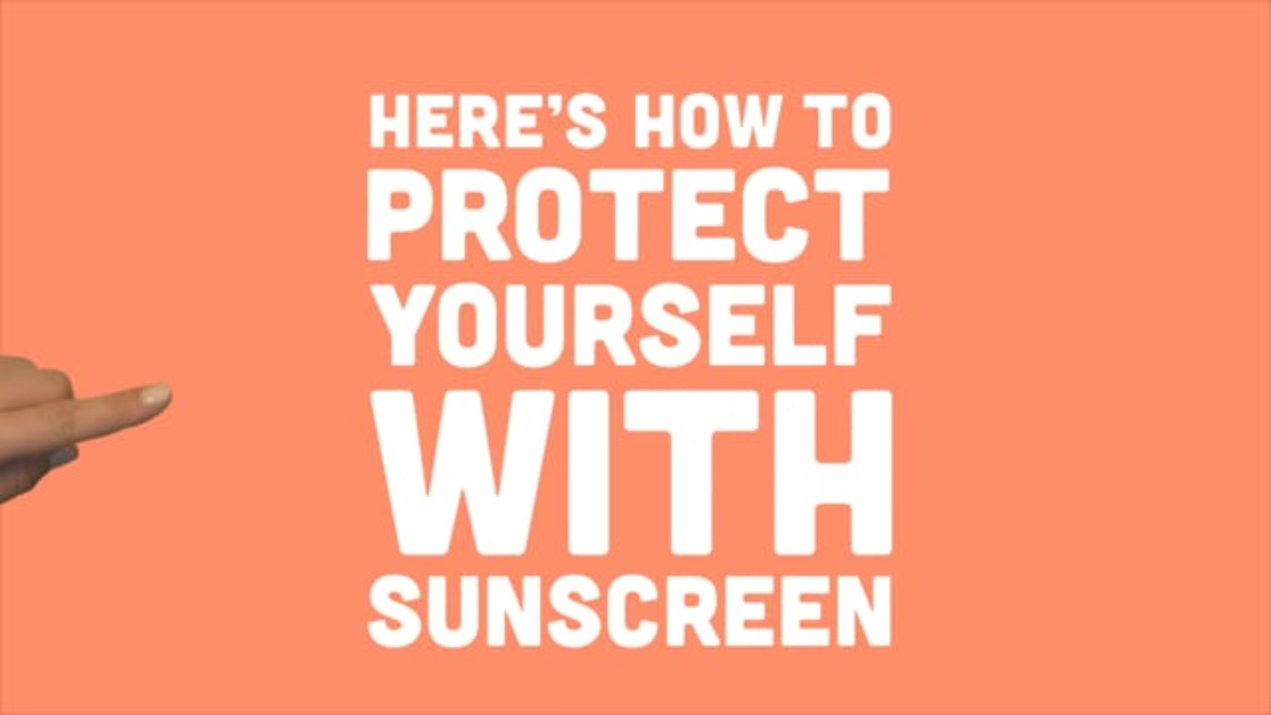
Sunscreen Station
Cancer Council - How to use sunscreen correctly - Vimeo
Cancer Council NSW, 2017
Notes:
Now let's watch a video that shows us the importance of wearing sunscreen and the way to apply it correctly.

Slide 8
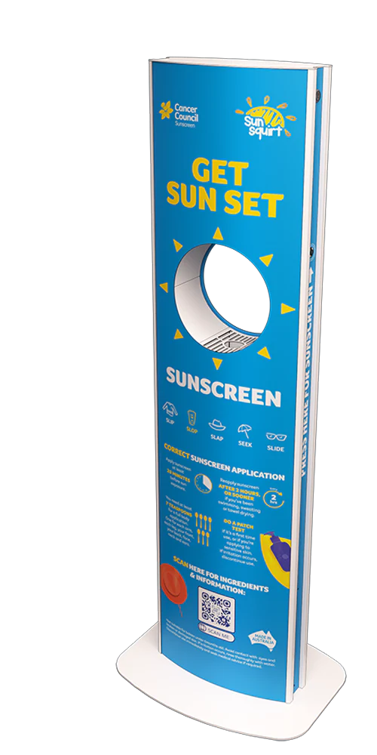
Sunscreen Station
Our risk of skin cancer can be reduced by applying sunscreen correctly, combined with other sun protection measures.
Sun protection measures including sunscreen MUST be used when the UV is 3 or above.
We propose installing a sunscreen station in [insert the specific area] and encouraging staff and students (through posters and communications) to use it before heading outside.
Notes:
To reduce our risk of skin cancer, we would like to install a sunscreen station for our staff and students to use before heading outdoors. Sunscreen reduces the amount of UV radiation reaching our skin by absorbing or filtering UV rays away from the skin, preventing damage to the cells below.
To promote heathy habits, we can provide sunscreen at school events, allow students time to apply sunscreen 20 minutes prior to outdoor activities, and direct students to reapply sunscreen at regular intervals during outdoor activities and events. For funding, [insert your plan here. For example: we would look to invite the P&C to fund the sunscreen station and ongoing supply of sunscreen' or 'we will run a fundraising activity etc.]

Slide 9
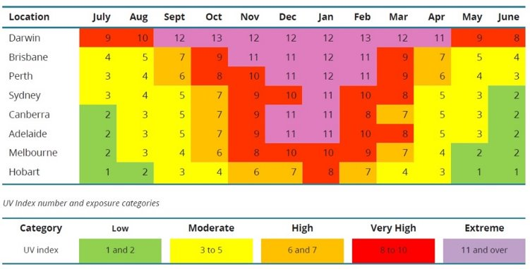
UV index awareness
Source: Cancer Council Australia 2016, published in AIHW Cancer in Australia 2019
Notes:
Like we said before, UV is responsible for 95% skin cancers in Australia. UV radiation cannot be seen or felt like light and the heat but it does a lot of damage. We might think that we don't need sun protection on cool or cloudy days but that is not true. UV radiation isn't affected by temperature. The level of UV can be the same whether the temperature is 20 degrees or 40 degrees. A UV radiation level of 3 is high enough to cause skin damage to unprotected skin. Cancer Council recommends sun protection measures to be used when the UV levels are 3 or above, regardless of the time of day or time of year. As we can see from this table, we need sun protection almost year-round in NSW.

Slide 10
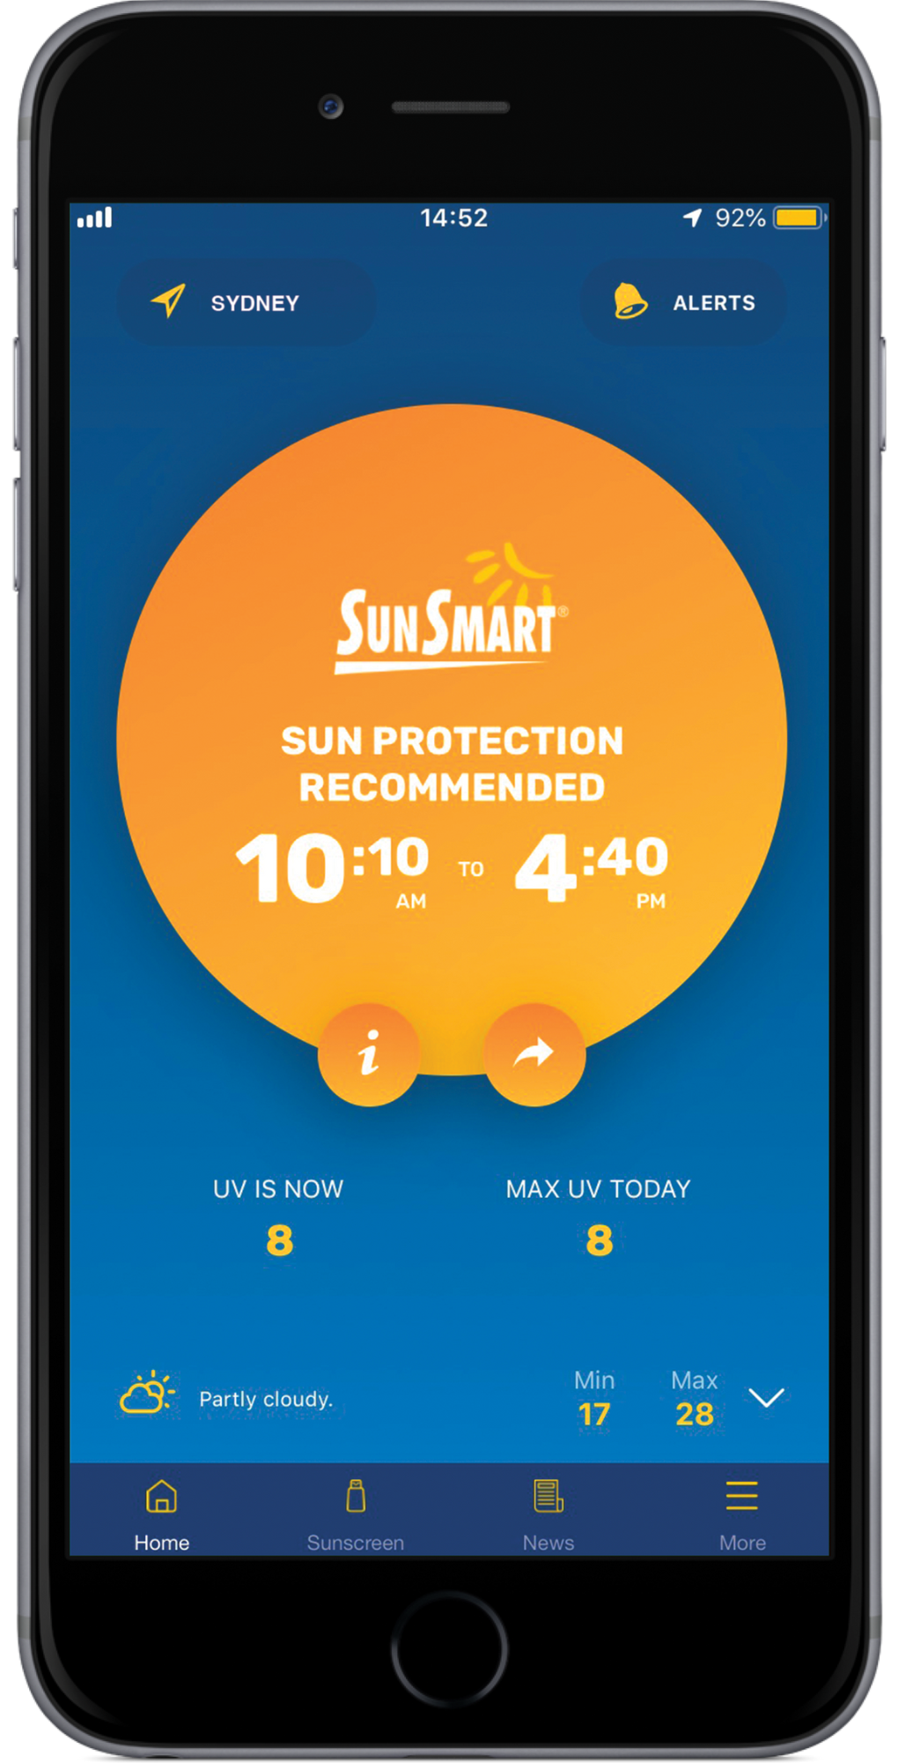
UV index awareness
We propose downloading the SunSmart app or the SunSmart Widget at our school and:
Including the highest weekly UV in [insert specific channel such as school news].
Showing the daily UV level on [insert specific area such as school TV monitor, smartboard, notice board].
Displaying the daily UV index in the playground.
Considering UV levels when scheduling outdoor events.
Notes:
By downloading the SunSmart app and/or SunSmart widget at our school, we can track daily UV levels and make informed choices for sun protection. It gives automatic recommendations for sun protection based on the UV levels of the day. It indicates the hours when sun protection is needed on any given day (e.g. 9:40am to 5:20pm). After downloading, we can show the UV level at various places around the school to motivate our school community to adopt sun protection measures.

Slide 11
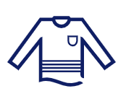
Sun Safe Mufti Day
Wearing clothing that covers as much skin as possible protects us from UV damage.
To celebrate mufti day, students will be required to wear UV protective clothing (i.e., collared shirts, elbow or full-length sleeves, longer shorts, skirts or long pants), hats (broad-brimmed, bucket, or legionnaire), and sunglasses (when outside).
Notes:
To protect ourself from UV radiation damage, we need to wear clothing that covers as much skin as possible because it is a physical barrier between our skin and UV radiation. It is one of the easiest and most effective ways to protect our skin from the sun as it can’t be wiped or washed off like sunscreen.

Slide 12

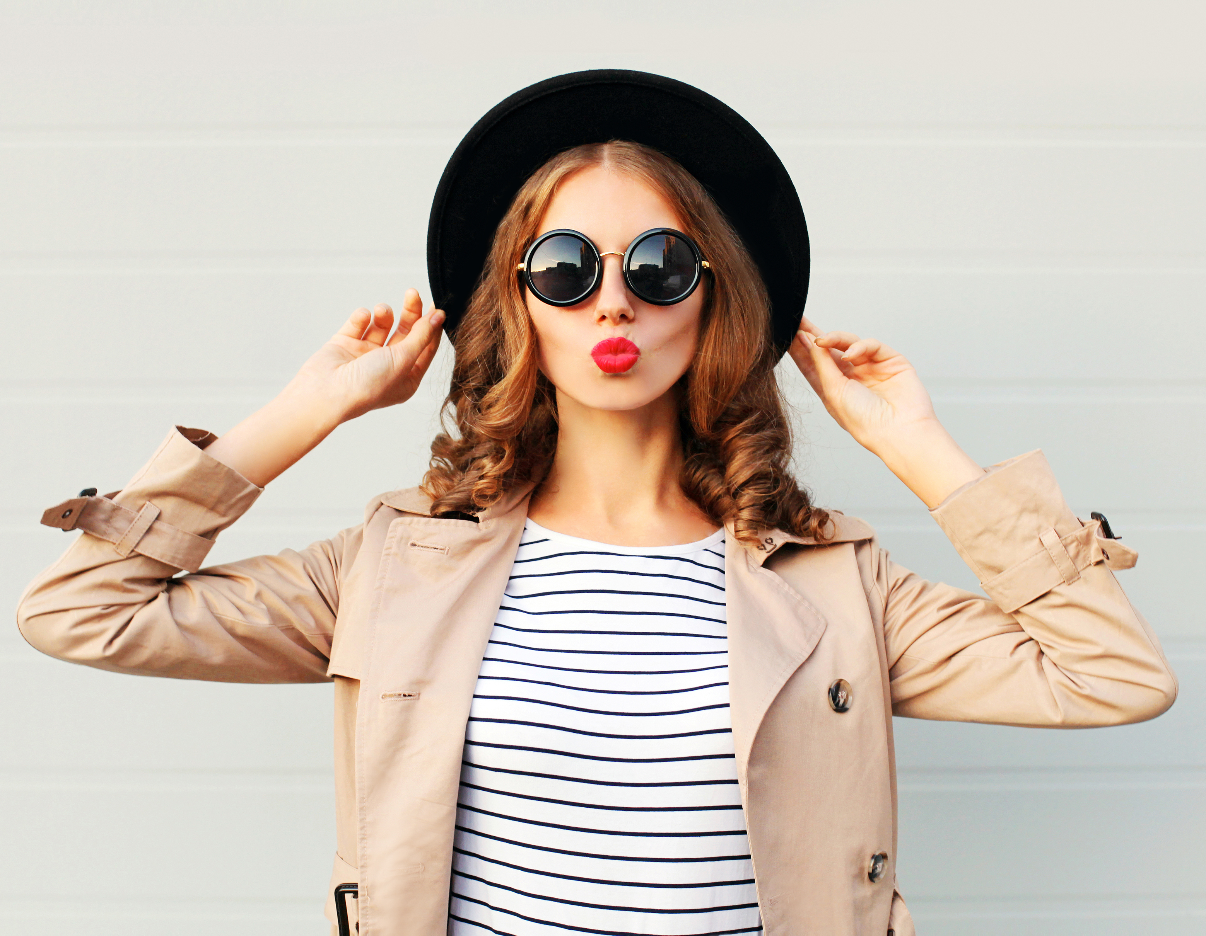
Sun Safe Mufti Day
Our proposal is to organise a Sun Safe Mufti Day on [insert specific date for the event and other details such as theme, activities, prizes, etc.], to [insert purpose of mufti day e.g. educate students about choosing sun safe clothing].
Notes:
Sun Safe Mufti Days are a great opportunity to build knowledge about sun safe clothing that protects against the harmful effects of UV radiation. A sun safe mufti day will help show our peers that we can practice sun safety without compromising our individuality and style!

Slide 13
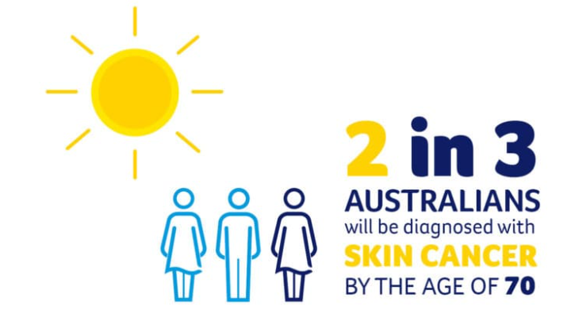
Sun Safe Comms Campaign
Childhood and adolescence are critical periods for practicing sun safety.
Staff and students need to better understand the harmful effects of UV radiation and protective measures for sun safety.
Notes:
Considering the high risk of skin cancer in Australia, staff, students, and our community need to better understand the harmful effects of UVR and protective measures we can all take to be sun safe. It is important for us to take sun safety seriously because these are critical periods for protecting ourselves from the high risk of developing skin cancer. Launching a sun safety awareness campaign within our school community is a great way to increase awareness of UV and the personal choices we can make to better protect ourselves. As sun safe champions, it is our responsibility to educate and empower our community to adopt sun safe practices.

Slide 14
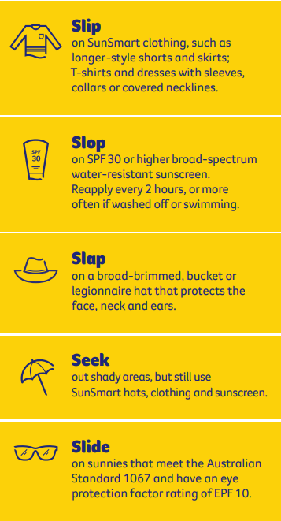

Sun Safe Comms Campaign
Our proposal is to create promotional material [insert your example ideas such as posters, flyers, photos, videos, newsletter inserts, social tiles] and use [insert the school's media channels such as their social media, newsletters, parent and school communication platforms] to disseminate sun safety messaging.
Notes:
For this initiative, we propose to run a sun safe communication campaign through our school's social media channels/print media so that students, parents, teachers, and the community can be aware of the dangers of UV exposure, the risk of skin cancer, and what sun protection measures we can take personally. Our aim is to engage the entire school community and create a culture of sun safety. In addition to disseminating sun safety messaging, this project will help us develop experience in communication, creativity, design, and literacy.

Slide 15

Duty of Care
Invest in us: Protect us from harm during these critical years! School interventions have been proven by studies to be both effective and cost‐effective to prevent skin cancer.
United Nations Convention on the Rights of the Child: "Children have the right to enjoy the highest attainable standard of health and to a safe environment."
Notes:
We need your support for this crucial sun safe initiative, so that we have the time and resources needed for success. We want to implement this small but effective initiative to help our school be safer from the harmful effects of UV now and into the future. We believe that this initiative will not only benefit our school community by enhancing knowledge and promoting healthier practices but also provide invaluable experiences and personal growth for our dedicated team of Sun Safe Champions. Are you committed to providing us with a sun safe environment?

Slide 16
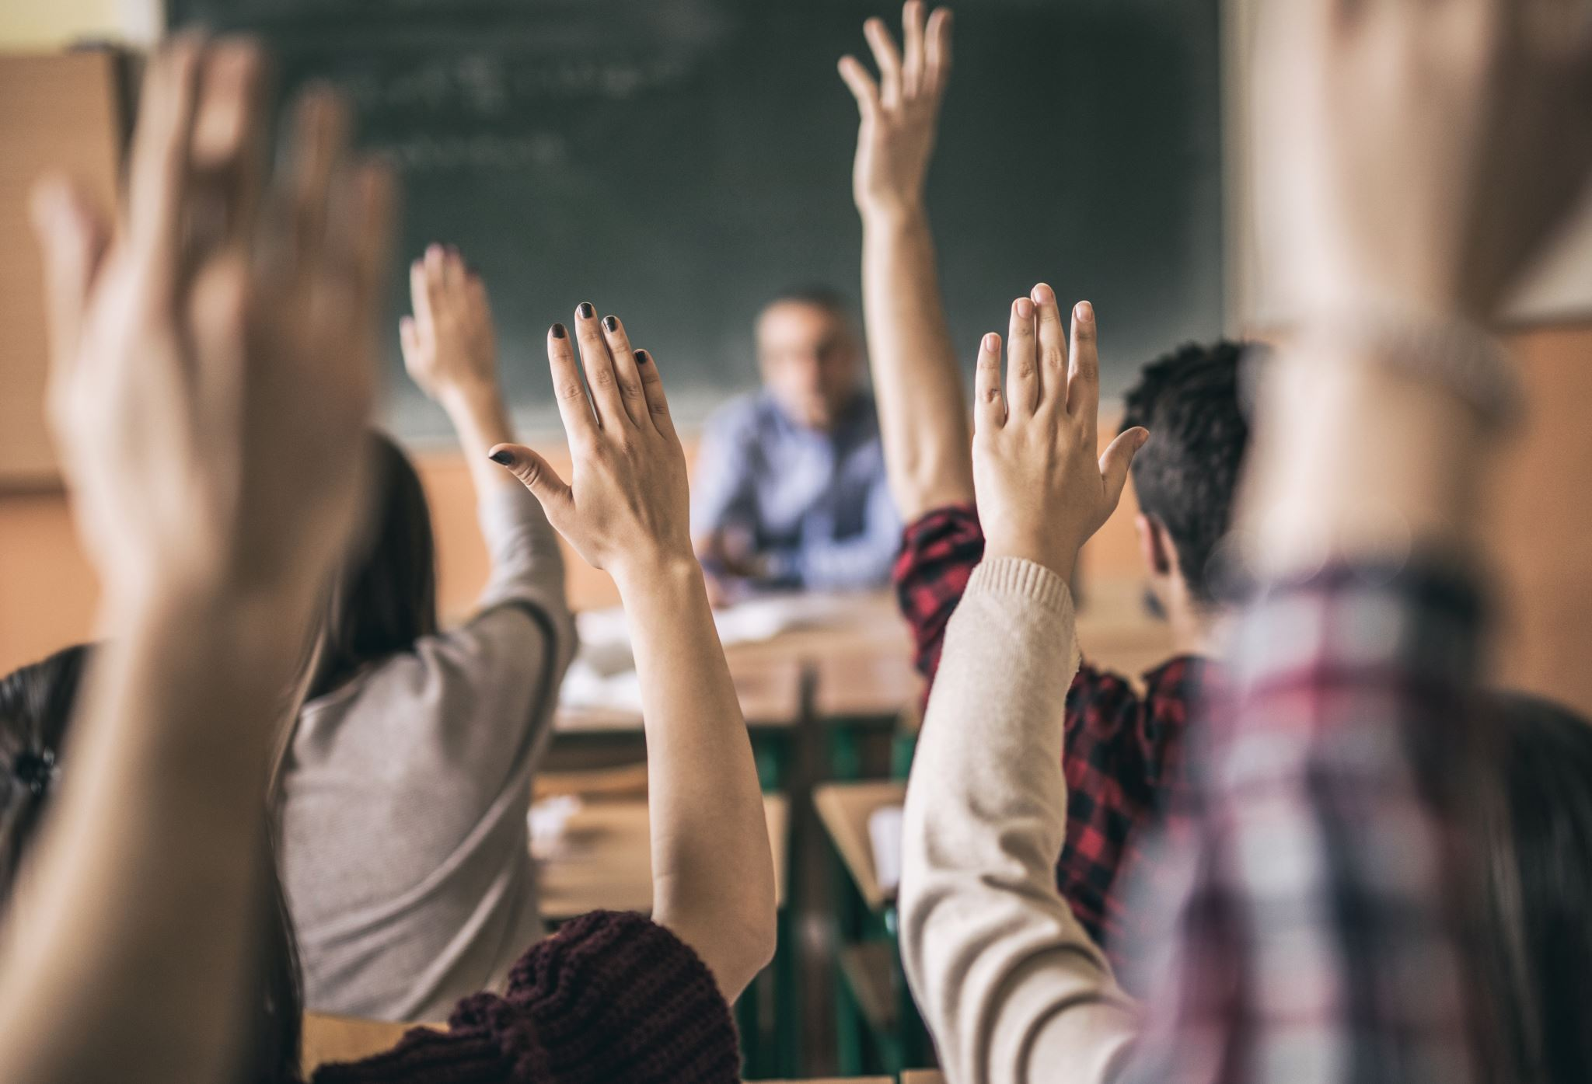
Thank you!
Questions?
Notes:
Thank you for listening and let us know if you have any questions!

